Slide 1
Uber Data Visualization Report
Praveen Raj.G
MBT 12

Slide 2
Overview
Uber is a global transportation company based in San Francisco, offering a range of services including ride-hailing, food delivery, and courier services.
They operate in numerous countries and cities worldwide, boasting a massive user base and a fleet of millions of drivers. With an average of 28 million trips facilitated daily, Uber has coordinated billions of trips since its inception. In 2023, the company generated significant revenue through its services, with a notable take rate for both mobility and food delivery.

Slide 3
Data Structuring and preprocessing
Data Loading and Structuring
Firstly I Load JSON file in Excel for structuring and preprocessing of Uber dataset
Data Cleaning and Preprocessing
No duplicates were found in dataset
Zero value datas are removed for data cleaning
Extract Year,Month,Week and day from pickup_datetime
Created new features such as travel_mode based on business rules
■ Passenger count < 3: "Uber Auto"
■ Passenger count = 4: "Uber Go"
■ Passenger count >4: "Uber XUV."

Slide 4
Fare price Trend
Trend: The line chart shows an upward trend in fare prices from 2009 to 2014. This suggests that the average fare has been increasing over this period
Insights:
Fare Price Increase: The most prominent insight is the consistent increase in fare prices throughout the observed years. This could indicate factors like inflation, increased demand, or changes in operating costs
Potential Drivers: To understand the reasons behind this trend, further analysis would be needed. Factors like fuel costs, competition, and economic conditions could play a role.
The visual clearly shows an increasing trend in fare prices from 2009 to 2014. This information can be used to understand the historical behavior of fare prices and potentially inform future pricing strategies

Slide 5
2. Most Popular Travel Mode
Insights:
Dominance of Uber Auto: The pie chart clearly shows that "Uber Auto" is the most popular travel mode among the options presented. This could be due to various factors like affordability, availability, or suitability for shorter distances.
Limited Usage of Other Modes: The relatively small sizes of the other segments indicate that "Uber XUV" and "Uber Go" are less frequently chosen by users. This could be attributed to higher fares, specific use cases, or limited availability in certain areas.
The visual clearly shows that "Uber Auto" is the most popular travel mode based on the data. This information can be used to understand user preferences, optimize service offerings, and make data-driven decisions regarding resource allocation and pricing.

Slide 6
3. Peak Hour Ride
Distribution:
The chart shows a clear pattern of ride count variation throughout the day.
There's a significant increase in ride count starting from around 6 PM, reaching a peak between 8 PM and 10 PM, and then gradually decreasing.
Insights:
Peak Hours: The visual clearly identifies the peak hours for rides. The period between 8 PM and 10 PM has the highest ride count, suggesting that this is the busiest time for the ride-sharing service.
Demand Pattern: The chart reveals a distinct pattern of demand throughout the day. There's a gradual increase in demand from early evening, reaching a peak during late evening, and then declining towards late night. This pattern likely reflects people's commuting and social activity patterns.

Slide 7
4. Most Frequent Location
Frequent location:The table clearly identifies the locations with the highest number of rides. This information can be valuable for understanding rider behavior, optimizing service allocation, and identifying areas with high demand.
Demand Variation: The variation in ride count across locations suggests that demand for ride-sharing services is not uniform across the city. Some areas are significantly busier than others, which can inform decisions about pricing, driver allocation, and service expansion.
The table effectively identifies the most frequently traveled locations based on ride count. This information can be used to understand rider behavior, optimize service operations, and make data-driven decisions to improve the efficiency and effectiveness of the ride-sharing service.

Slide 8
5. Passenger Count across trips
Insights:
Overall Trend: The chart shows a clear upward trend in passenger count as the ride count increases, suggesting a positive correlation between the number of rides and the number of passengers carried.
Travel Mode Impact: The segmentation by travel mode reveals interesting patterns:
Uber XUV: This category has the highest passenger count across all ride counts, indicating that it likely involves larger vehicles with higher passenger capacity.
Uber Go: This mode shows a moderate passenger count, suggesting it might be suitable for smaller groups or individuals.
Uber Auto: This category has the lowest passenger count, which is expected as auto-rickshaws typically have limited seating capacity.
Ride Count Distribution: The distribution of ride counts seems to be skewed towards lower values, with more bars representing lower ride counts.

Slide 9
6. Fare Price vary by Travel mode
Insights:
Fare Variation: The chart clearly shows that the average fare prices vary significantly across the different travel modes.
Uber XUV has the highest average fare, likely due to the larger vehicle size and potentially higher operating costs.
Uber Go has a moderate average fare, suggesting it is priced for budget-conscious riders.
Uber Auto has the lowest average fare, which is expected given the smaller vehicle size and generally lower operating costs.
Mode Choice and Price Sensitivity: The fare differences suggest that riders may choose travel modes based on price sensitivity. Passengers looking for the most affordable option might opt for Uber Auto, while those prioritizing comfort or space might choose Uber XUV, despite the higher fare.

Slide 10
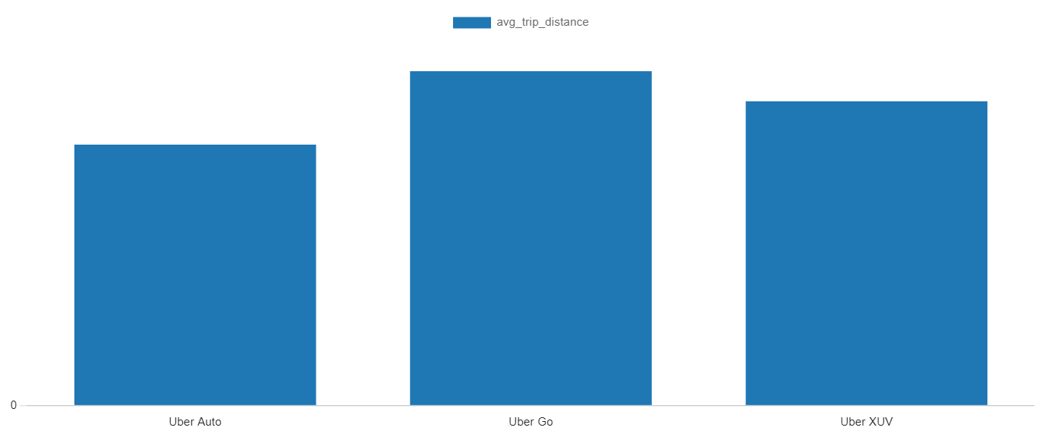
7. Average Trip distance by Travel Mode
This insights got by postgresql query visualization bar chart
According to the observation
Uber XUV has the highest average trip distance, suggesting that riders using this service tend to travel longer distances.
Uber Auto has the lowest average trip distance, indicating that it's likely used for shorter commutes.
Uber Go falls between the two in terms of average distance.

Slide 11
8. Average Fare by Hour
Insights:
Hourly Fare Variation: The chart clearly shows significant variation in average fare prices across different hours of the day. There is a distinct peak around the 6th hour (which could correspond to 6 AM) and a second peak around the 11th hour (which could correspond to 11 PM). This suggests that demand and pricing are influenced by time of day.
Peak Hours: The two peaks in the chart indicate potential peak hours for ride-sharing services. This information could be valuable for drivers and riders alike:
Drivers: Knowing the peak hours could help them optimize their schedules to maximize earnings.
Riders: Understanding the peak hours could help them anticipate potential fare increases and plan their travel accordingly.
Off-Peak Hours: The chart also reveals potential off-peak hours with lower average fares. This information could be beneficial for budget-conscious riders who are flexible with their travel times.

Slide 12
9. Weekday & Weekend ride count
This insights gained from postgresql query output
Geographic Distribution of Trips: The data points suggest a concentration of pickup locations in the Manhattan area of New York City, given the longitude and latitude values.
Weekday vs. Weekend Ridership: The table shows that there is significant variation in the number of trips between weekdays and weekends for different pickup locations. Some locations have a much higher number of weekday trips compared to weekends, while others have a more balanced distribution.
Potential Hotspots: Certain locations with high values in both "weekday_trips" and "weekend_trips" can be identified as potential hotspots for ride-hailing services, indicating a high demand for rides.

Slide 13
10. Average Fare for Specific Location
Insights:
Geographic Variation in Fares: The table shows that average fares vary significantly across different pickup locations. This could be due to several factors:
Distance to Destination: Rides starting from locations farther from popular destinations or those with limited transportation options might have higher fares.
Demand and Supply: Areas with high demand and limited driver availability might experience higher fares due to surge pricing.
Traffic Congestion: Locations in areas with heavy traffic might lead to longer travel times and consequently higher fares.
Potential Hotspots: Identifying locations with consistently higher fares could help in understanding areas with high demand and potentially profitable routes for drivers.

Slide 14
Conclusion
Overall Summary
The dashboard provides a comprehensive overview of Uber ride data, offering insights into various aspects such as fare trends, passenger count, popular travel modes, peak hours, and fare variations across different locations and travel modes.
Key Insights:
Fare Price Trend: The line chart shows an upward trend in average fares over time. This could be attributed to various factors like inflation, increased demand, or changes in service pricing.
Passenger Count: The bar chart shows a positive correlation between ride count and passenger count, indicating that as the number of rides increases, so does the number of passengers carried.

Slide 15
Insights
Average Fare by Hour: The line chart reveals distinct peaks in average fares during certain hours of the day, suggesting higher demand and potentially higher fares during these peak hours.
Popular Travel Modes: The pie chart shows the distribution of rides across different travel modes, indicating which modes are most frequently used by passengers.
Peak Hour Rides: The bar chart highlights the number of rides during different hours of the day, identifying peak hours with high ridership.
Fare Prices Vary by Travel Mode: The bar chart demonstrates that average fares differ significantly across different travel modes. This suggests that factors like vehicle size, operating costs, and passenger capacity influence the pricing of each travel mode.
Average Fare for Specific Location: The table shows variations in average fares across different pickup locations, suggesting that factors like distance to destination, demand and supply, and traffic congestion likely influence fare prices.

Slide 16
Thank you

